Slide 1


Travel Compliance
Will Tate, Partner will@goldspringconsulting.com

Slide 2
Compliance: Definition?
Travel Policy
Air
Hotel
Rental Car
Ground Transportation
Booking Channel
Shared Economy
One Day Trips
Teleconferencing
Trip Disruption
Card Usage
Duty of Care

Slide 3
Punctuate the Following:
“ A woman without her man is nothing”
Men wrote:
“ A woman, without her man, is nothing”
Women wrote:
“ A woman: without her, man is nothing”
Different Perspectives, Different Emphasis

Slide 4

Compliance: Why does it matter all?
Framing acceptability
Valuing the Current Frame
Diminishing Discounts

Slide 5
Policy Compliance ROI Example

Slide 6
Service (and / vs.) Compliance

Slide 7

Service (and / vs.) Compliance
Are these at odds?
Why or why not?
Share examples

Slide 8
Value to Buyers & Sellers Compliance

Slide 9
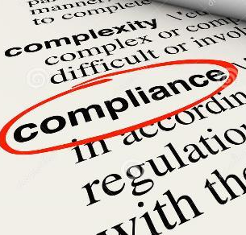
Compliance: What does it do for buyers?
Easiest Sell
Management Understanding
Creates innovation opportunities
What Else?

Slide 10

Compliance: What does it do for sellers?
Partnership value
Easier to keep than acquire customers
Shows your greatness
What Else?

Slide 11
Example: Hotel Compliance: What’s the value?

Slide 12
Hotel Compliance: What’s the value?
What other “values” of compliance are missing here?

Slide 13
Hidden Costs Avoided with Compliance

Slide 14
What are the “Hidden Costs” of non-compliance?
No hotel discount (Staying at preferred hotel but not with discount since not booked at right rate)
No recursive rate checking (TripBam/YAPTA)
Missed Commission Income
Missed Corporate Card / Dining Card Rebates
Missed Additional Insurance coverages
Voids within window at TMC
Ancillaries – priority boarding/seating, baggage
Productivity – good seating allows work on flights
No show charges – cancel flight but forget hotel separately have no show

Slide 15
Demographic Compliance

Slide 16
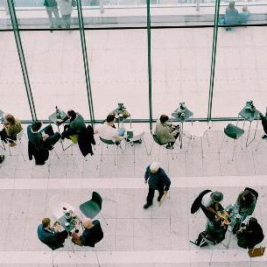
Compliance by Group
Do demographics matter?
What groups are most compliant?
Why?
Do you measure by group?

Slide 17
Multi-Generational Workforce
Source: BCG Research

Slide 18
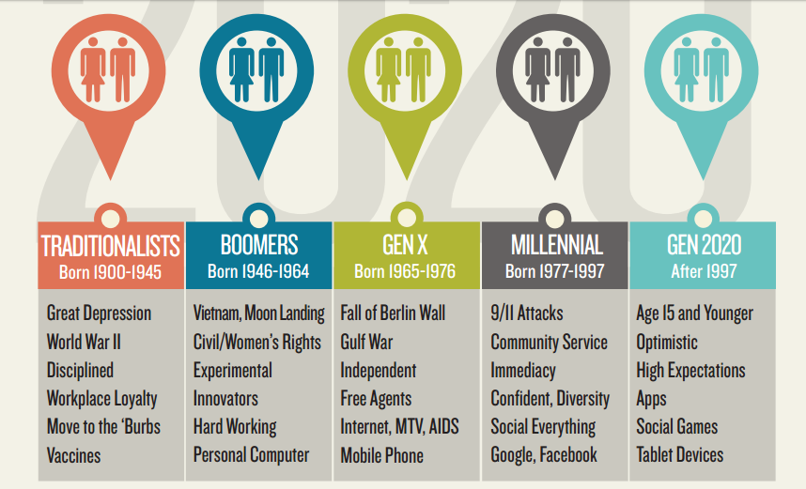
The Generations in the Workplace
Source: FutureWorkplace.com

Slide 19

Managing Generational Differences
Educate on the “Why”
Utilize Technology
Value vs. Cost
Address Bleisure
Embrace Diversity

Slide 20
Duty of Care and Compliance

Slide 21

Duty of Care
The Catch All
What are the objections?
How to Sell

Slide 22
Channel Compliance

Slide 23
The Right Infrastructure
Traveler service
Designated Booking Channels
  Complimentary technologies (TRIPBAM, Yapta, TMC itinerary apps, etc.)
  POS differentiated fees to create travel budget for TM
Open booking
Supplier Direct Sales

Slide 24
Airline Compliance

Slide 25
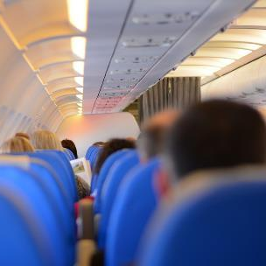
Engaged Airline Partners
What is the value?
Running the numbers
Value of Deal
  Hard Dollars
  Soft Dollars
  Others?

Slide 26
Per Ticket Examples
Source: BCG Research

Slide 27
Air Compliance ROI – Savings Dollars

Slide 28
Air Compliance ROI – %

Slide 29
Hotel Compliance

Slide 30
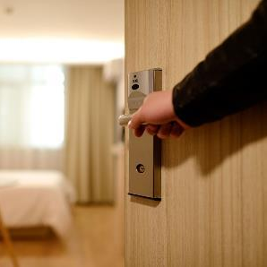
Engaged Hotel Partners
What is the value?
Running the numbers
Value of Deal
  Hard Dollars
  Soft Dollars
  Others?

Slide 31
Per Hotel Cost Examples
Average 2 Nights

Slide 32
Chain Summary Support
# | Preferred Hotel Company | Rooms | % Support
9 | GLOBAL HOTEL ALLIANCE | 358 | 29%
5 | IHG | 838 | 28%
3 | STARWOOD | 2,751 | 16%
1 | MARRIOTT | 10,781 | 13%
4 | HYATT | 1,598 | 13%
7 | PREFERRED HOTEL GROUP | 576 | 13%
2 | HILTON | 10,098 | 0%
10 | FAIRMONT RAFFLES SWISSOTEL | 289 | -5%
6 | SYNXIS CORPORATION | 454 | -7%
8 | LANGHAM HOTELS | 306 | -40%

Slide 33
Chain Summary Support
# | Preferred Hotel Company | Rooms | % Support
9 | GLOBAL HOTEL ALLIANCE | 358 | 29%
5 | IHG | 838 | 28%
3 | STARWOOD | 2,751 | 16%
1 | MARRIOTT | 10,781 | 13%
4 | HYATT | 1,598 | 13%
7 | PREFERRED HOTEL GROUP | 576 | 13%
2 | HILTON | 10,098 | 0%
10 | FAIRMONT RAFFLES SWISSOTEL | 289 | -5%
6 | SYNXIS CORPORATION | 454 | -7%
8 | LANGHAM HOTELS | 306 | -40%
55% Non Compliant
(All Preferreds: 45% Compliance)
% Support OVER non-compliant measure
Positive Indicates brand loyalty
Negative indicates policy support
What about the others?
Staying because of Policy

Slide 34
Air/Hotel Totals

Slide 35
Compliance Storytelling

Slide 36
Total Cost of Non Compliance

Slide 37
Telling the Story: Equivalent Sales $
What's easier: new sales or managing employees?

Slide 38
Telling the Story: Compliance Growth

Slide 39
Telling the Story: Compliance Savings

Slide 40
Telling the Story: % Value of Compliance
Compliance by Trip
Number of Non-Compliant Trips | 1,200
Avg Non-Compliant Trip Cost | $916.70
Cost of All Non-Compliant Trips | $1,100,040
Savings on Compliant Trips | 17.2%
Potential Compliance Savings | $189,207
$11K per 1% Compliance

Slide 41
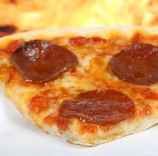
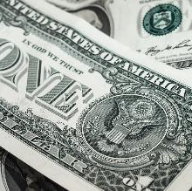
Telling the Story: For your Culture

Slide 42
Compliance Storytelling
Risk management
Value of each 1% non-compliant
Show as Net Profit to equivalent Sales Dollars
Value of strong policy, moderate policy, no policy
Service Stories
Others?

Slide 43
Travel Compliance
Will Tate, Partner will@goldspringconsulting.com

Slide 44
EXTRA SLIDES-Not to be Presented

Slide 45
Airline Compliance

Slide 46
Engaged Airline Partners
What is the value?
Running the numbers
Value of Deal
  Hard Dollars
  Soft Dollars
  Others?

Slide 47
Per Ticket Examples
Source: BCG Research

Slide 48
Per Ticket Examples
Source: BCG Research

Slide 49
Per Ticket Examples
Source: BCG Research

Slide 50
Per Ticket Examples
Source: BCG Research

Slide 51
Air Compliance ROI – Dollars

Slide 52
Air Compliance ROI – %

Slide 53
Preferred Carrier Support
AIRLINE | SEGS | EXPECTED | SUPPORT | %
Preferred | 22,319 | 20,952 | 1,367 | 6.5%
SQ | 1911 | 1678 | 233 | 13.9%
UA | 8044 | 7500 | 544 | 7.3%
AA | 6645 | 6397 | 248 | 3.9%
ZH | 1922 | 1894 | 28 | 1.5%
LH | 1790 | 1784 | 6 | 0.3%
CZ | 1702 | 1698 | 4 | 0.2%
CA | 1267 | 1275 | -8 | -0.6%
MU | 1770 | 1813 | -43 | -2.4%
WN | 2175 | 2498 | -323 | -12.9%
DL | 3798 | 4602 | -804 | -17.5%

Slide 54
Preferred Carrier Support
AIRLINE | SEGS | EXPECTED | SUPPORT | %
Preferred | 22,319 | 20,952 | 1,367 | 6.5%
SQ | 1911 | 1678 | 233 | 13.9%
UA | 8044 | 7500 | 544 | 7.3%
AA | 6645 | 6397 | 248 | 3.9%
ZH | 1922 | 1894 | 28 | 1.5%
LH | 1790 | 1784 | 6 | 0.3%
CZ | 1702 | 1698 | 4 | 0.2%
CA | 1267 | 1275 | -8 | -0.6%
MU | 1770 | 1813 | -43 | -2.4%
WN | 2175 | 2498 | -323 | -12.9%
DL | 3798 | 4602 | -804 | -17.5%
All Preferreds: +6.5%
What about the others?

Slide 55
Ground Transportation Compliance

Slide 56
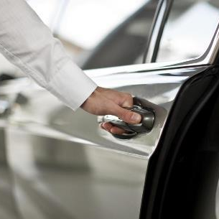
Engaged Ground Providers
Running the numbers
Value of Deal
  Hard Dollars
  Soft Dollars
  Others?

