Slide 1
Know Before You Go:
GBTA Convention 2026
Your Guide to Making the Most of Convention

Slide 2
The Basics
GBTA Convention 2026 Overview
Resources
What: GBTA Convention 2026 — the 57th annual Convention and the premier global business travel event
When: Monday, August 3 – Wednesday, August 5, 2026
Where: McCormick Place, 2301 S Martin Luther King Dr, Chicago, IL 60616
Who: 5,500+ business travel professionals — buyers, suppliers, exhibitors, and industry leaders from around the world
Website:
convention.gbta.org
Hashtag:
#GBTA2026
Questions? conventionhelp@gbta.org

Slide 3
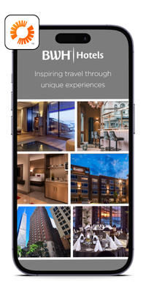


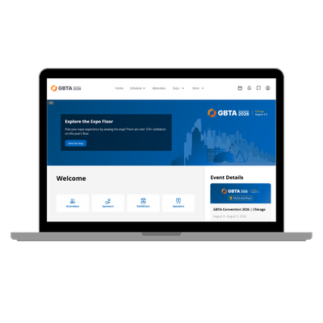
Registration & Attendee Tools
Confirm your registration at convention.gbta.org
Download the GBTA Convention Mobile App
Log in to the Attendee Hub (web-based) to start building your schedule
Your app and the Attendee Hub sync — saved sessions and appointments carry across both
Update your profile with a photo, a headline, and social media links, as well as adjust your visibility preferences
Have your QR code or full email handy for badge pickup
← Mobile App
Attendee Hub →

Slide 4
Agenda at a Glance
Monday, August 3 |  | Tuesday, August 4 |  | Wednesday, August 5
6:45 – 8:00 AM | 5K Run/Walk | 8:00 – 8:45 AM | Education Sessions | 8:00 – 8:45 AM | Education Sessions
9:30 – 10:15 AM | Connect First Orientation | 9:15 – 10:00 AM | Education Sessions | 9:15 – 10:00 AM | Education Sessions
12:00 – 1:00 PM | Buyer Buzz (Buyers Only) | 10:15 – 11:00 AM | Education Sessions | 10:15 – 11:00 AM | Education Sessions
1:00 – 4:00 PM | Official Opening: Expo | 11:30 AM – 12:45 PM | Main Stage | 11:30 AM – 12:45 PM | Main Stage
4:30 – 5:45 PM | Main Stage | 1:00 – 1:45 PM | Chapter Day Lunch | 1:00 – 1:45 PM | Networking Lunch
5:45 – 7:30 PM | Welcome Reception | 1:45 – 6:15 PM | Expo | 1:45 – 6:15 PM | Expo

Slide 5
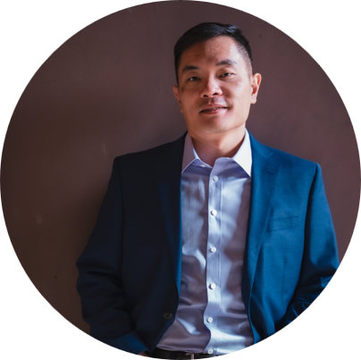
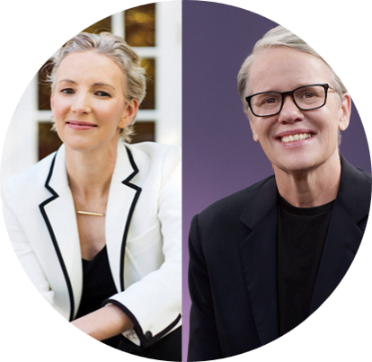
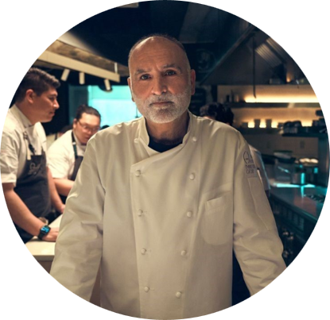
Monday, August 3
MAIN STAGE KEYNOTES
Tuesday, August 4
Wednesday, August 5
Jia Jiang
Embracing Rejection
Anne Morriss & Frances Frei
Move Fast and Fix Things
Chef José Andrés
Fireside Chat

Slide 6
Education Sessions
When: Tuesday and Wednesday mornings, three rounds each day (8:00, 9:15, and 10:15 AM)
What: 85+ sessions designed by industry peers through a rigorous peer-review process featuring real-world, practitioner-led content
Topics span: Operational efficiency, technology & AI, supplier strategy, risk & compliance, sustainability, leadership, and more
How to choose: Browse sessions in the mobile app or Attendee Hub and add them to your personal schedule
Pro Tip:
Up to 15 sessions run in parallel — review your options in advance so you don't miss the ones that matter most to you

Slide 7
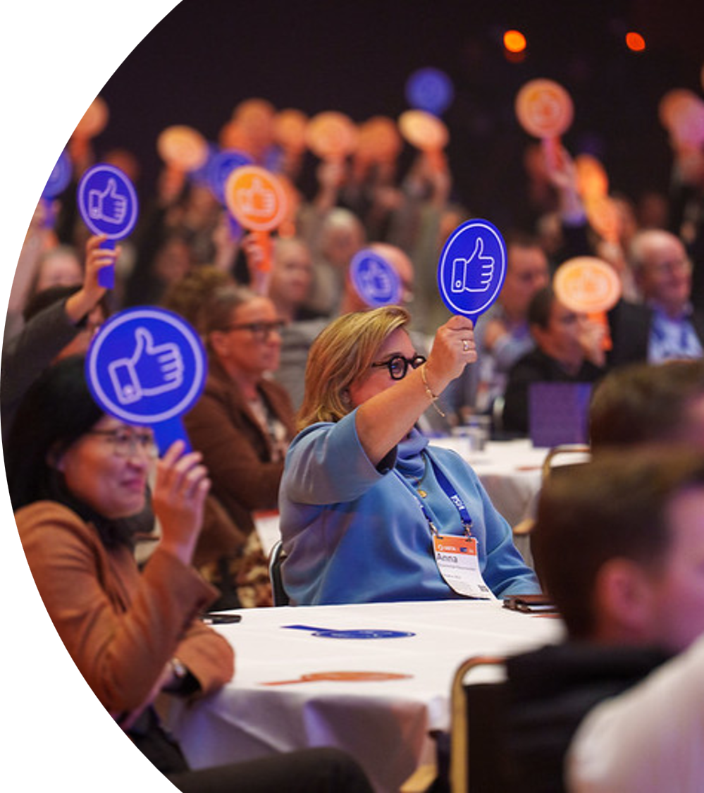
Buyer Access+ Highlights
Exclusively for Travel Buyers
Braindates
Monday 10:00–11:45 AM
Tuesday & Wednesday 8:00–11:00 AM
Sign up via the mobile app. Located on the 400 level near Education Sessions.
Buyer Buzz
Monday, 12:00–1:00 PM
An exclusive buyer-only lunch with fast-paced, interactive programming hosted by CEO Suzanne Neufang.

Slide 8
Expo
10.5 hours across three days!
Pro Tips:
Expo Hours
Monday 1:00–4:00 PM
Quick Facts
300+ exhibitors and 130,000+ sq ft of exhibit space
Tuesday 1:45–6:15 PM
Wednesday 1:45–4:45 PM
Schedule appointments in advance via the app to make the most of your time
Explore the latest tools, technologies, and solutions for business travel
Wear comfortable shoes!
Earmark Wednesday afternoon for quality conversations
Use the exhibitor directory to identify your "must-visit" booths

Slide 9
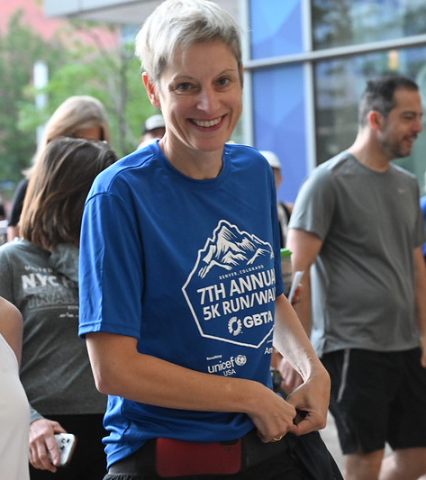
Networking & Social Events
5K Run/Walk
Monday, 6:45 AM
Start your Convention with a lakeside run along Chicago's beautiful lakefront
Welcome Reception
Monday, 5:45–7:30 PM
A high-energy celebration with live music, Chicago-themed food, and custom cocktails/mocktails
Networking Lunches
Tuesday & Wednesday, 1:00–1:45 PM
Buffet-style lunch between Main Stage and Expo — a great time to connect with fellow attendees

Slide 10
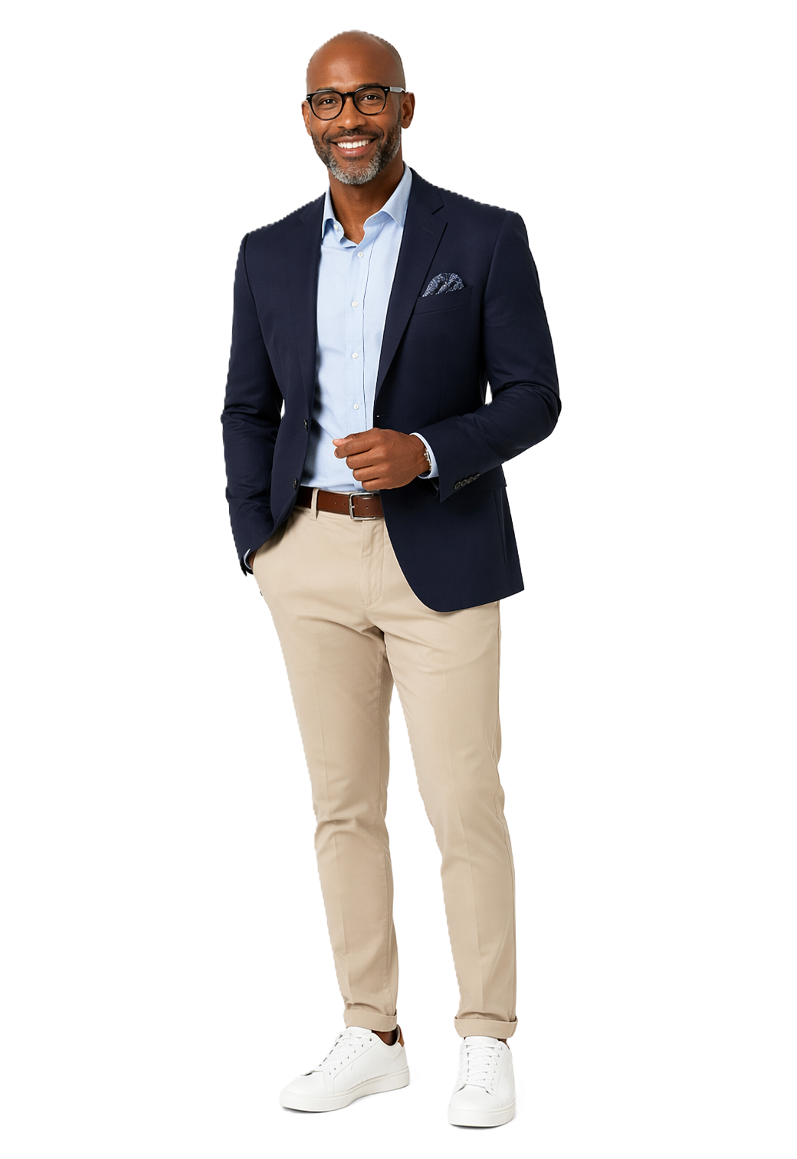
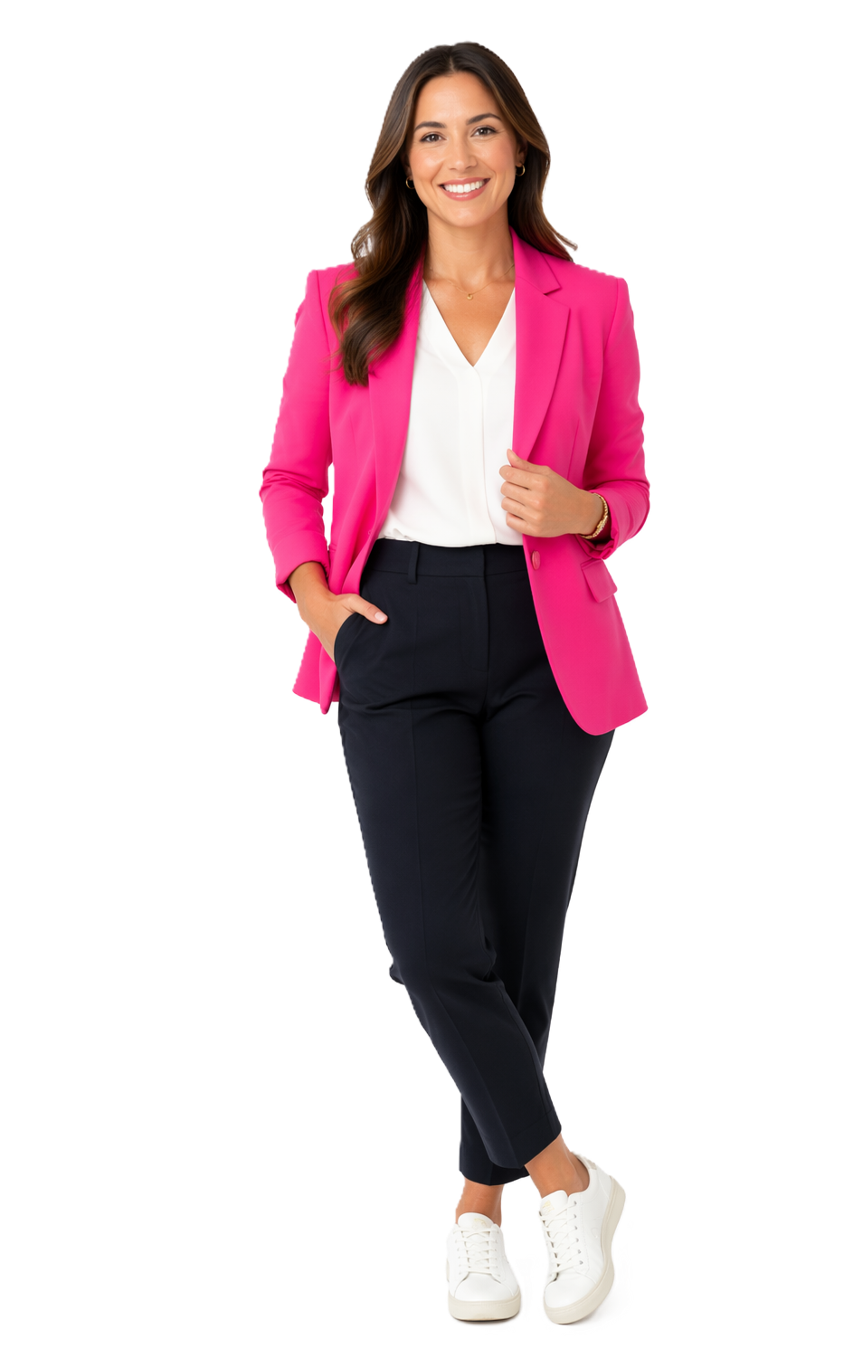
What to Wear
Convention days (Mon–Wed): Business casual is the standard. Think smart but comfortable — you'll be on your feet and moving between sessions, Expo, and networking events.
Welcome Reception (Monday evening): Business casual — you may want to layer as it’s partially taking place outdoors on the terrace.
5K Run/Walk: Athletic wear and good running/walking shoes
  Pro Tip:
  Wear comfortable shoes — McCormick Place is large and you'll be walking a lot. Layers are also smart since convention center temperatures can vary.

Slide 11
Tips for First Timers
1 | Attend Connect First on Monday morning — it's designed specifically for you and includes venue tours so you know where everything is
2 | Build your schedule in advance using the mobile app and set Expo appointments before you arrive
3 | Bring plenty of business cards (or have your digital contact info ready to share)
4 | Pace yourself — it's a marathon, not a sprint. Take breaks, hydrate, and recharge when you need to
5 | Use the hashtag #GBTA2026 on social media to join the conversation and connect with fellow attendees
6 | Ask Convention Ambassadors for help — they're GBTA member volunteers stationed throughout the venue to help you navigate

Slide 12
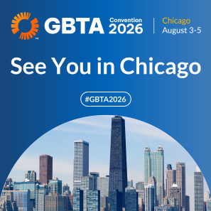
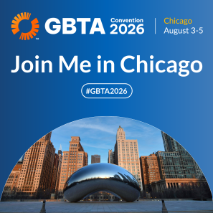
Stay Connected
Website: convention.gbta.org
Mobile App: Download the GBTA App → Search "Convention"
Social Media: Follow GBTA on LinkedIn, Instagram, YouTube, Facebook
Hashtag: #GBTA2026
Questions? conventionhelp@gbta.org
Social Hub: convention.gbta.org/social-media

Slide 13
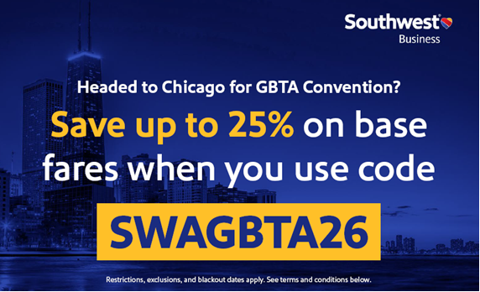
DISCOUNTS ON SOUTHWEST

Slide 14
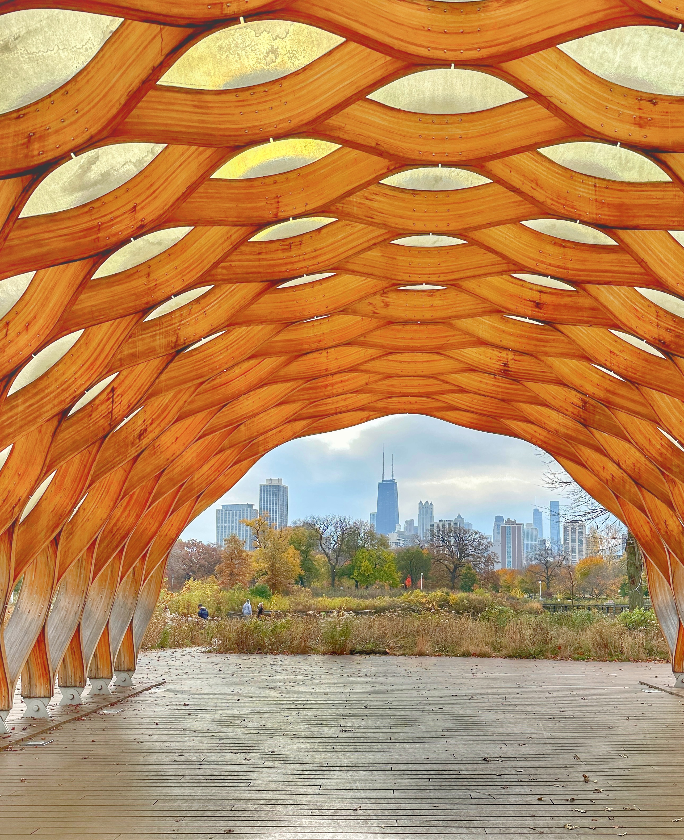
See you in Chicago!
Download the app. Build your schedule. Come ready to connect, learn, and grow.

